Slide 1

AMAZON WEB SERVICES (Applied Data Science) Session 2 Topics - S3, CLI
Dr. Nilay Karade
Academic Program Manager

Slide 2
Agenda
Budget
S3 bucket storage
Create bucket
Upload and download objects
Versioning
Encryption
Lifecycle rules
Command line interface
Installation
Keys
Login
S3 commands
Assignment

Slide 3
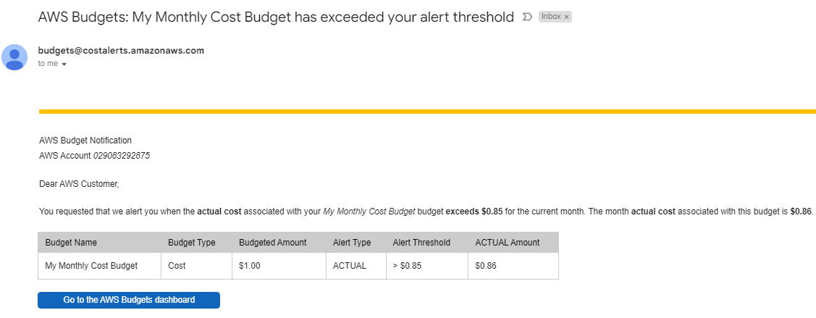
AWS Budget & Billing

Slide 4
Amazon Simple Storage Service (S3)
Amazon Simple Storage Service (S3) is a highly scalable and durable object storage service provided by Amazon Web Services (AWS).
It allows users to store and retrieve virtually any amount of data in the cloud, making it one of the most popular cloud storage solutions available.
An S3 bucket is a container used to store objects (files) in S3. Buckets have a unique name globally across all AWS accounts.
It is used in the URL to access the objects stored in the bucket.
S3 allows you to create multiple buckets, and each bucket can store an unlimited number of objects.

Slide 5
Operations Performed with S3
Create a Bucket: Users can create an S3 bucket through the AWS Management Console, AWS CLI, or SDKs. The bucket name, region, and access control settings need to be specified during the creation process.
Upload Objects: Users can upload objects (files) to an S3 bucket. These objects can be of any type, such as images, videos, documents, etc. Users can upload objects through the AWS Management Console, AWS CLI, SDKs.
Download Objects: Objects stored in an S3 bucket can be downloaded by users with the appropriate permissions. Users can download objects through the AWS Management Console, AWS CLI, SDKs, or using direct URLs.
Manage Object Permissions: S3 allows fine-grained control over object access permissions. Users can set permissions for objects at the bucket level or at the individual object level. This includes granting read, write, and delete permissions to specific users or groups.

Slide 6
Operations Performed with S3
Versioning: S3 provides versioning support, allowing users to keep multiple versions of an object. This feature helps in maintaining data integrity and recovering from accidental deletions.
Server-Side Encryption: S3 allows users to enable server-side encryption for their objects. This ensures that the data stored in S3 is encrypted at rest, providing an additional layer of security.
Lifecycle Policies: S3 offers lifecycle policies that automate the management of objects based on predefined rules. Users can define policies to transition objects to cheaper storage classes or delete them after a specified period.
Static Website Hosting: Users can host static websites by enabling static website hosting on an S3 bucket. This allows the bucket to serve HTML, CSS, JavaScript, and other files to users as a public website.

Slide 7
AWS Command Line Interface (CLI)
It is a unified tool provided by Amazon Web Services (AWS) that allows users to interact with various AWS services from the command line of your operating system.
With AWS CLI, you can manage and automate AWS resources and services directly from the terminal or command prompt, making it a powerful and efficient tool for developers, system administrators, and anyone working with AWS.

Slide 8
Key features of AWS CLI include
_{Unified Tool:}
AWS CLI provides a single, unified interface for interacting with multiple AWS services. This means you can use the same commands and syntax to work with different AWS resources.
_{Command Autocompletion:}
AWS CLI offers autocompletion support, allowing you to quickly discover and complete commands, options, and resource names by pressing the "Tab" key.
_{Scripting and Automation:}
With AWS CLI, you can write scripts and automate tasks, making it easier to manage and configure AWS resources in a programmatic way.

Slide 9
Key features of AWS CLI include
_{Support for AWS Profiles:}
AWS CLI supports multiple profiles, allowing you to switch between different AWS accounts or IAM roles when working on different projects.
_{Output Formats:}
You can customize the output format of AWS CLI commands, making it easier to parse and use the command outputs in scripts or pipelines.
_{AWS Service Coverage:}
AWS CLI covers a wide range of AWS services, including EC2, S3, RDS, Lambda, CloudFormation, IAM, and many more.

Slide 10
AWS CLI Installation
Installation guide https://docs.aws.amazon.com/cli/latest/userguide/getting-started-install.html#getting-started-install-instructions
Windows AWS CLI download link - https://awscli.amazonaws.com/AWSCLIV2.msi

Slide 11
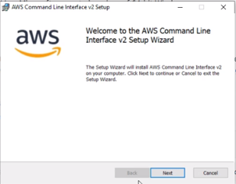

Slide 12
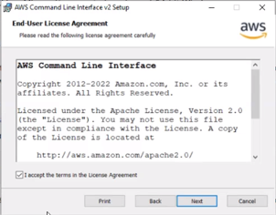

Slide 13
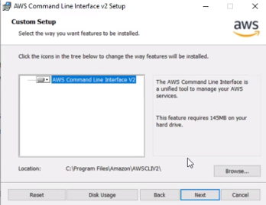

Slide 14
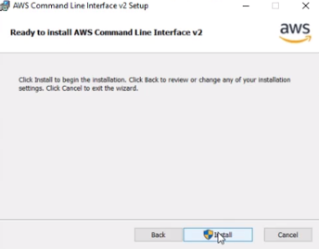

Slide 15
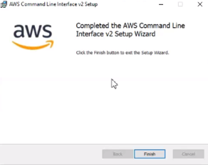

Slide 16
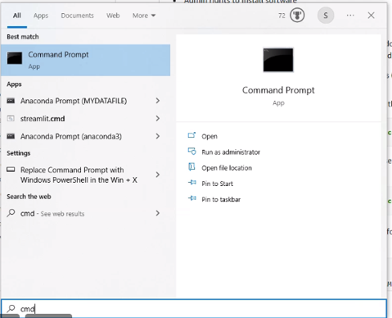

Slide 17
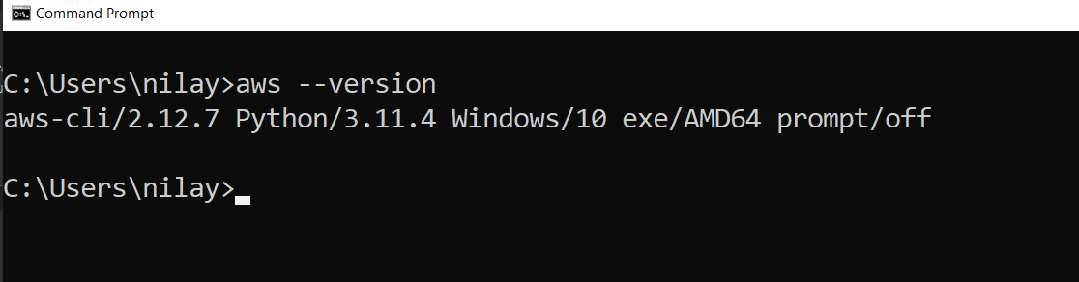

Slide 18
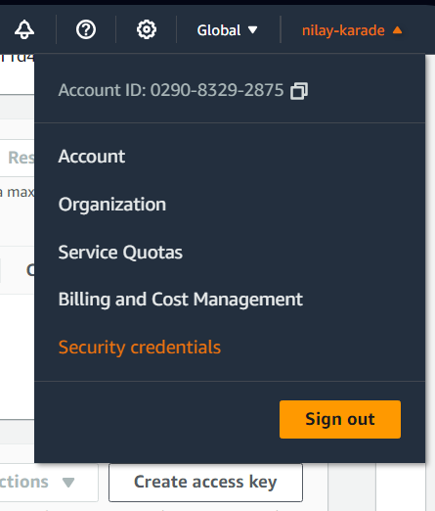
CLI Login

Slide 19
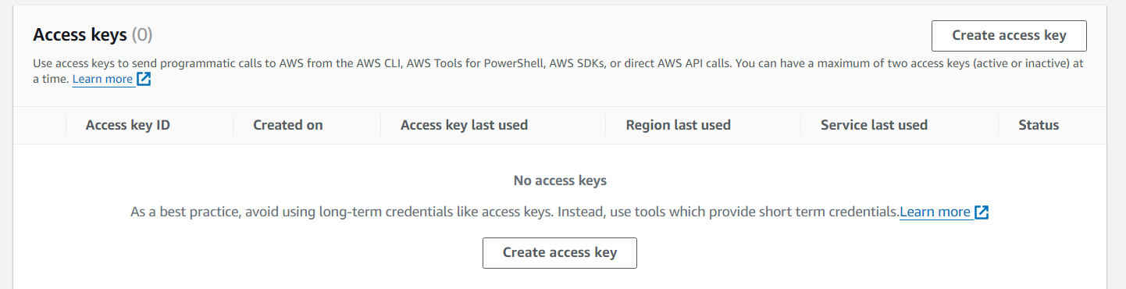
Create access key

Slide 20
AWS CLI Command structure Source- https://docs.aws.amazon.com/
The AWS CLI uses a multipart structure on the command line that must be specified in this order:
The base call to the aws program.
The top-level command, which typically corresponds to an AWS service supported by the AWS CLI.
The subcommand that specifies which operation to perform.
General AWS CLI options or parameters required by the operation. You can specify these in any order as long as they follow the first three parts. If an exclusive parameter is specified multiple times, only the last value applies.
$ aws <command> <subcommand> [options and parameters]
Parameters can take various types of input values, such as numbers, strings, lists, maps, and JSON structures. What is supported is dependent upon the command and subcommand you specify.
The following example lists all of your Amazon S3 buckets.
aws s3 ls
2018-12-11 17:08:50 my-bucket
2018-12-14 14:55:44 my-bucket2

Slide 21
AWS CLI commands
Listing Buckets:
Command: aws s3 ls
Example: aws s3 ls
This command lists all the S3 buckets in your AWS account along with their creation dates.
Listing Objects in a Bucket:
Command: aws s3 ls s3://your-bucket-name
Example: aws s3 ls s3://my-example-bucket
This command lists all the objects (files and folders) in the "my-example-bucket".

Slide 22
AWS CLI commands
Creating a Bucket:
Command: aws s3 mb s3://your-bucket-name
Example: aws s3 mb s3://my-example-bucket
This command creates a new S3 bucket named "my-example-bucket".
Uploading Objects to a Bucket:
Command: aws s3 cp /path/to/local/file s3://your-bucket-name/destination-key
Example: aws s3 cp ~/Documents/example.txt s3://my-example-bucket/documents/
This command uploads the file "example.txt" from the local machine's "~/Documents" directory to the "documents" folder in the S3 bucket "my-example-bucket".

Slide 23
AWS CLI commands
Downloading Objects from a Bucket:
Command: aws s3 cp s3://your-bucket-name/source-key /path/to/local/destination
Example: aws s3 cp s3://my-example-bucket/images/cat.jpg ~/Downloads/
This command downloads the file "cat.jpg" from the "images" folder in the S3 bucket "my-example-bucket" to the local machine's "~/Downloads" directory.
Copying Objects between Buckets or Locations:
Command:
aws s3 cp s3://source-bucket/source-key s3://destination-bucket/destination-key
Example:
aws s3 cp s3://my-source-bucket/images/cat.jpg s3://my-destination-bucket/backups/
This command copies the file "cat.jpg" from "my-source-bucket" to the "backups" folder in "my-destination-bucket".

Slide 24
AWS CLI commands
Deleting Objects from a Bucket:
Command: aws s3 rm s3://your-bucket-name/object-key
Example: aws s3 rm s3://my-example-bucket/documents/old-file.txt
This command deletes the file "old-file.txt" from the "documents" folder in "my-example-bucket".
Enabling Bucket Versioning:
Command: aws s3api put-bucket-versioning --bucket your-bucket-name --versioning-configuration Status=Enabled
Example: aws s3api put-bucket-versioning --bucket my-versioned-bucket --versioning-configuration Status=Enabled
This command enables versioning for the S3 bucket "my-versioned-bucket", allowing multiple versions of objects to be stored.

Slide 25
Boto
Boto is the Python SDK (Software Development Kit) provided by Amazon Web Services (AWS) for interacting with various AWS services, including Amazon S3 (Simple Storage Service).
You can use Boto to programmatically access and manipulate S3 buckets and objects from your Python applications.

Slide 26
AWS Identity and Access Management (IAM)
AWS IAM) that enables you to securely manage access to AWS resources.
IAM allows you to control who can use your AWS services (authentication) and what actions they can perform on those resources (authorization).
It is a fundamental component of AWS security, and it helps you maintain security and compliance in your AWS environment.

Slide 27
IAM (Identity Access Manager)
AWS Identity and Access Management (IAM) is a crucial service provided by Amazon Web Services (AWS) that allows you to securely control access to AWS resources and services.
Users and Groups:
IAM allows you to create IAM users, which represent individual people or applications, and IAM groups, which are collections of IAM users. By creating users and groups, you can manage permissions and access for multiple users together.
Roles:
IAM roles are similar to IAM users, but they are not associated with a specific person or application. Instead, IAM roles are used to grant permissions to entities outside of AWS, such as EC2 instances, Lambda functions, or other AWS services.
Policies:
IAM policies are JSON documents that define the permissions and actions that are allowed or denied for specific IAM users, groups, or roles. You can attach policies to IAM entities to manage their access to AWS resources.
Credential Management:
IAM provides access to security credentials (access keys, secret access keys, and session tokens) that can be used to access AWS resources programmatically through APIs or AWS CLI.

Slide 28
Summary
S3 bucket storage
Create a Bucket,
Upload Objects,
Download Objects,
Manage Object Permissions,
Versioning,
Server-Side Encryption,
Lifecycle Policies
Command line interface
Installation
S3 related commands

